Slide 1

Credit Risk Evaluation from LendingClub.com
Inder Grang

Slide 2



Topics
Prediction
Results without Scaler
Results with Scaler

Slide 3

Prediction
Expect the RandomForestClassifier to get better results than logistic regression
Also since there is a wide range of values of the variables, Scaler may provide better results than non scaled data.
This is because there are too many variables (92) and I suspect most of them fall under the “noisy” category

Slide 4
Results from Non scaled data
Type of model | Training Score | Testing Score
LogisticRegression | 0.71 | 0.56
RandomForestClassifier | 1.0 | 0.63

Slide 5
Results from Scaled data
Type of model | Training Score | Testing Score
LogisticRegression | 0.71 | 0.75
RandomForestClassifier | 1.0 | 0.63

Slide 6
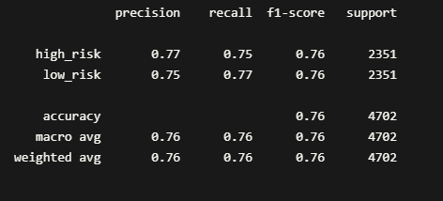
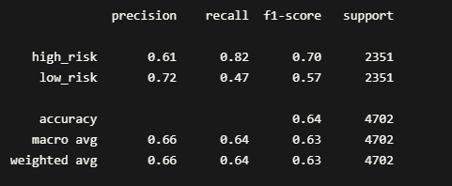
Classification report (scaled)
Logistic Regressionv
RandomForestClassifier

Slide 7
Summary
No change in performance of RandomForestClassifier with or without scaling
Logistic Regression improved substantially after scaling
Logistic Regression needed more iterations to converge from default of 100 to 1000.
Implies that there aren’t as many noisy inputs as I had initially predicted.

